Slide 1
Exploring Citibike Data
By: Sean Lee

Slide 2
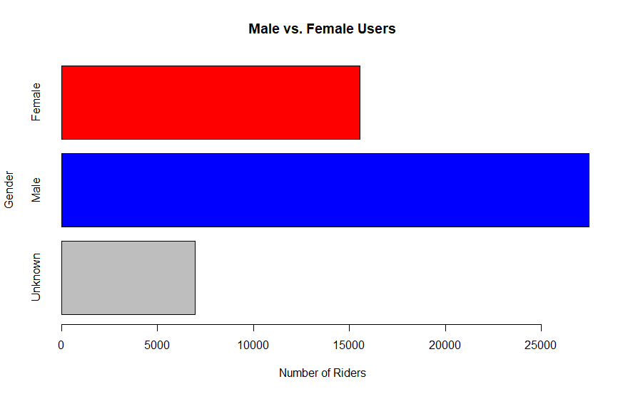
Males Ride More than Females
The histogram comparing male users to female users shows that more males use the Citibike service than females
Even if all unknown users are female, there would still be more male riders than female Riders
Citibike may want to focus their advertising strategy to grow their female userbase

Slide 3
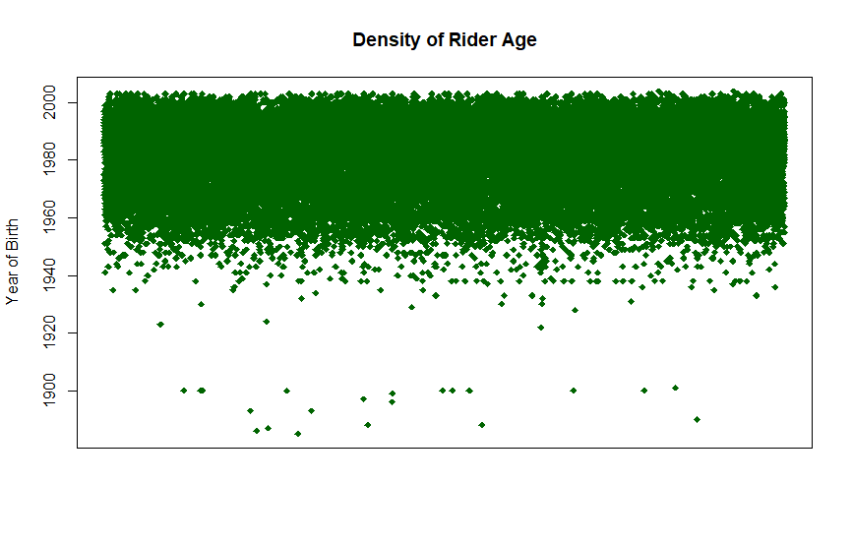
Majority of Riders are Age 60 or Less
The majority of riders are under the age of 60
Some of the data may be inaccurate as there are users who have put their year of birth as being before 1900
Citibike should focus their advertisements in the under 60 category because that is the age of the majority of riders

Slide 4
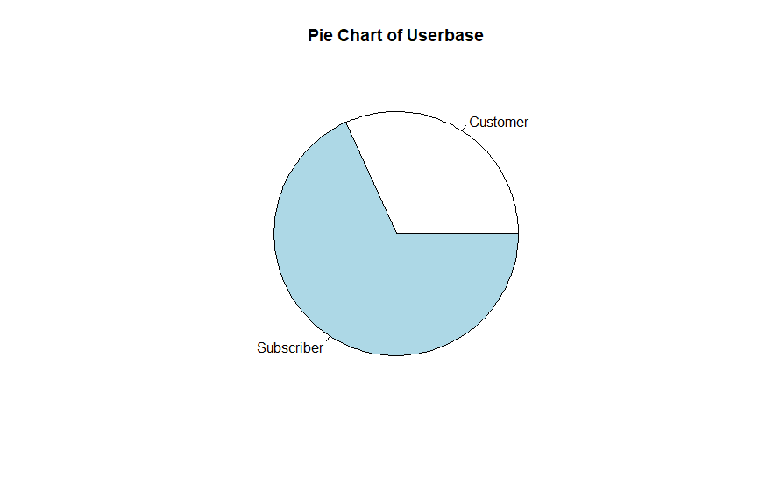
Customers vs. Subscribers
This pie chart shows that the majority of users are subscribers
Citibike may want to increase the number of subscribers to increase their profit margin
A marketing strategy promoting the benefits of the subscription model may help to increase the number subscribers

